Slide 1
CERVEAU NOUVEAUTE
Early Detection of Alzheimer's, Parkinson's, and Brain Tumor using Convolutional Neural Network

Slide 2
TABLE OF CONTENTS:
Introduction
What are we solving
How are we Solving
Future Plans
Tech Stack used
Conclusion

Slide 3
INTRODUCTION
Alzheimer's (AD) disease is a high-risk and atrophic neurological illness that slowly and gradually destroys brain cells, On the other hand Parkinson’s disease is a neurological disorder with more than 6 million people worldwide suffering from it.
It is commonly diagnosed using clinical assessments and progression scale which usually depends on the medical practitioner’s expertise ,and accuracy varies greatly between various examiners which also takes a long time to accurately diagnose (i.e. neurons) whereas,
Brain Tumors could lead to life threatening conditions. Therefore, the early detection of AD and other brain related plays a crucial role in preventing and controlling its progression.
For classification of AD, Parkinson’s and Brain Tumour in the early stage, classification systems and computeraided diagnostic techniques have been developed. Previously, machine learning approaches were applied to develop diagnostic systems by extracting features from neural images.
Currently, deep learning approaches have been used in many real-time medical imaging applications

Slide 4
Alzheimer’s Disease
Alzheimer's disease is the most common cause of dementia, and it is typically characterized by the accumulation of abnormal proteins in the brain, including beta-amyloid plaques and tangles.
Alzheimer's disease is a progressive neurodegenerative disorder that affects the brain, leading to a gradual decline in cognitive function, memory loss, and changes in behavior, mood, and personality.
It is characterized by the accumulation of beta-amyloid plaques and tau protein tangles in the brain, leading to the death of brain cells and cognitive decline. The disease is most common in older adults.
It is the most common cause of dementia among older adults.
There is no cure for Alzheimer's, but treatments can help manage symptoms and improve quality of life.

Slide 5
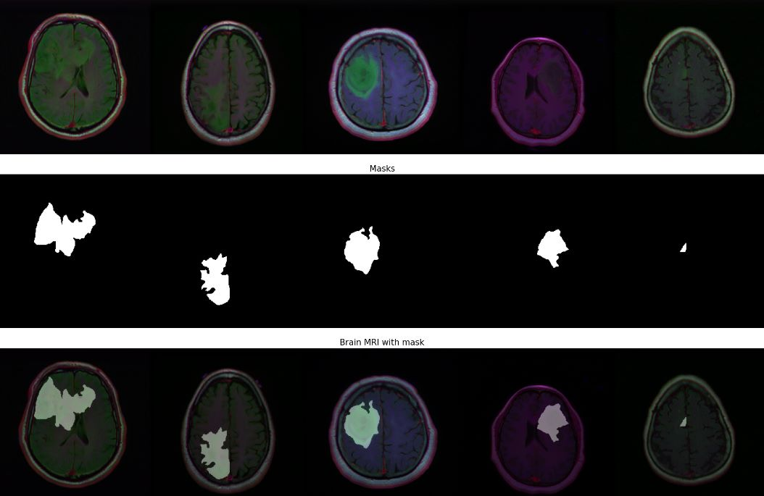

Slide 6
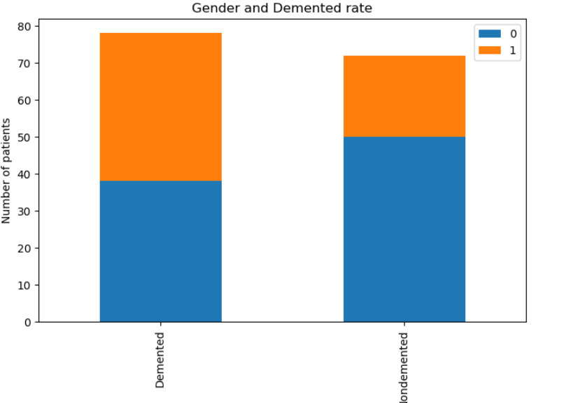

Slide 7
Brain Tumor Disease
Brain tumors are abnormal growths of cells in the brain or its surrounding tissues.
There are two types of brain tumors - primary tumors that originate in the brain itself and secondary tumors that spread from other parts of the body.
The symptoms of a brain tumor can vary depending on the size, location, and type of tumor, but can include headaches, seizures, vision or hearing problems, and changes in mood or personality.
Treatment for brain tumors may involve surgery, radiation therapy, chemotherapy, or a combination of these treatments, depending on the size and location of the tumor and the patient's overall health.
Brain tumors can be benign (non-cancerous) or malignant (cancerous), with malignant tumors being more aggressive and potentially life-threatening.
The causes of brain tumors are not well understood, but some risk factors include exposure to radiation, family history of brain tumors, and certain genetic conditions.

Slide 8
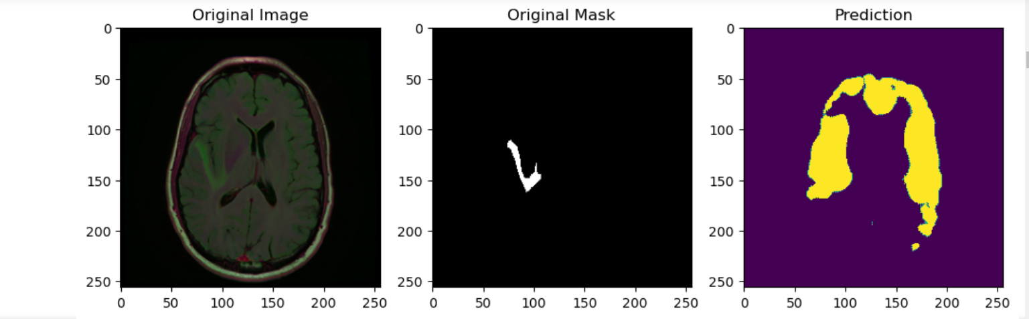

Slide 9
Parkinson Disease
0
Parkinson's disease is a chronic neuro disorder that primarily affects the motor system, resulting in symptoms such as tremors, rigidity,no body movements,etc..
Test for Parkinson Disease
The individual is asked to draw a spiral pattern on a piece of paper or a digital drawing tablet using a pen or stylus. The individual may be given specific instructions, such as drawing a spiral from the center outward or drawing a spiral within a designated area. The individual's drawing is collected as data for analysis.
Detecting from the Test
spiral roundness, curvature, and number of turns, as well as temporal features, such as pen speed, pen pressure, and direction changes.

Slide 10
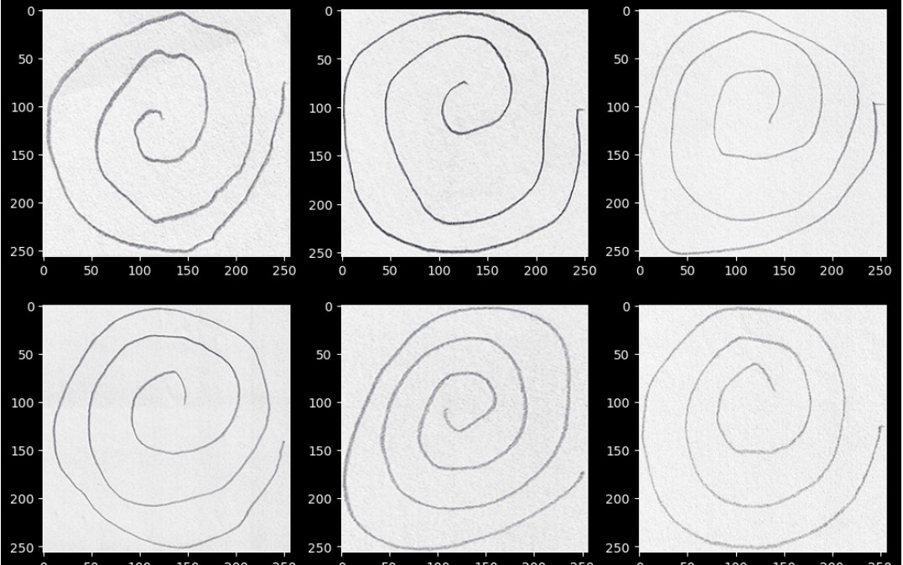
Spiral Drawing of the Normal Persons:

Slide 11
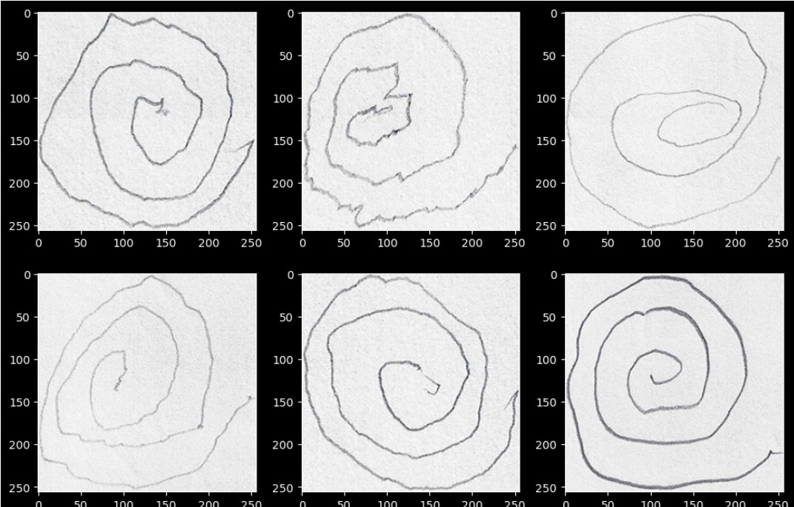
Drawings of Parkinson’s Patients:

Slide 12
Current Scenario:
01
02
Poorly detected Alzheimer’s disease
Alzheimer’s Detection
03
04
Brain Tumour Detection
Parkinson’s Disease
Due to poor detection of alzheimer’s it makes it difficult for one to early detect the presence of disease
We are using MRI scans and masking them for early detection of Alzheimer’s
Currently brain tumours cannot predict future brain tumour presence so we will make a prediction of brain Tumour via looking for Dementia
We cant detect parkinson accurately so we are using CNN advanced detecting technique

Slide 13
What are we trying to solve:
The main objective is to design an end-to-end framework for early detection of Alzheimer’s, Parkinson’s disease and Brain Tumor and medical image classification for varies stages. A deep learning approach, specifically convolutional neural networks (CNN), is used in this work. Four stages of the AD spectrum are multi-classified along with initial and stages of Parkinson’s disease.
Furthermore, separate binary medical image classifications are implemented between all three neurological disorders Different methods are used to classify the medical images and detect AD, Parkinson’s disease and Brain Tumour respectively.
Toseek to construct a very reliable and accurate model for the early phase detection of these diseases by merging the different datasets, applying the sophisticated image processing techniques, and ML algorithms. Our initiatives will be more significant and could lead to advancements in patient diagnostics and the healthcare industry. If this model is developed successfully, it will significantly alter how medical sciences have evolved in the future and pave the way for diagnosis.
The images present in the dataset have varying brightness, colour and noise, to remove these unwanted elements from our training and testing images, we apply image filtering operations and histogram equalisation for contrast enhancement, for better identifiable features.

Slide 14
How are we solving
CNN: The first method is based on simple CNN architectures that deal with 2D and 3D structural brain MRI.
These architectures are based on 2D and 3D convolution.
The activation function, that we are using here is ‘softmax’ function, as it is a multi-class sigmoid function.
The Optimizer, we use here is ‘adam’.The loss function, we use here is ‘SparseCategoricalcrossentropy’ function.
The first method uses simple CNN architectures that deal with 2D and 3D structural brain scans from the such diseases Neuroimaging Initiative (ADPP) dataset based on 2D and 3D convolution.
The second method applies the transfer learning principle to take advantage of the pre-trained models for medical image classifications. In this study, we suggest an AI model that aids in the recognition of various disorders through the classification of images.
CNN gives higher performance than other classifiers.
Machine learning accuracy is 84.6 % in SVM model with precision of 0.92 and a loss of 0.124 and the CNN accuracy is 92.7 % wit precision 0.941.

Slide 15
Masking of the MRI images:
Any remaining non-brain regions can be eliminated from the image by applying a binary mask.
The image can then be divided into several parts of interest for additional analysis using this mask.
To further the mask and guarantee that only the pertinent portions of the image are included in the study, we can also employ methods like morphological operations or clustering algorithms.
Compared to manual masking, automated thresholding techniques are quicker and more effective, but they might not be as accurate, particularly when the contrast between the lesion and the surrounding tissue is not clearly

Slide 16
Datasets Used:
Neuroimaging Datasets: Neuroimaging datasets, such as MRI (Magnetic Resonance Imaging) or PET (Positron Emission Tomography) scans, are widely used in predicting Alzheimer's or Parkinson's disease.
These datasets typically include images of the brain that can provide structural, functional, or metabolic information.
Neuroimaging datasets can be used to develop prediction models that analyze features extracted from the brain images, such as brain regions, cortical thickness, or functional connectivity, to predict the presence or progression of Alzheimer's or Parkinson's disease.

Slide 17
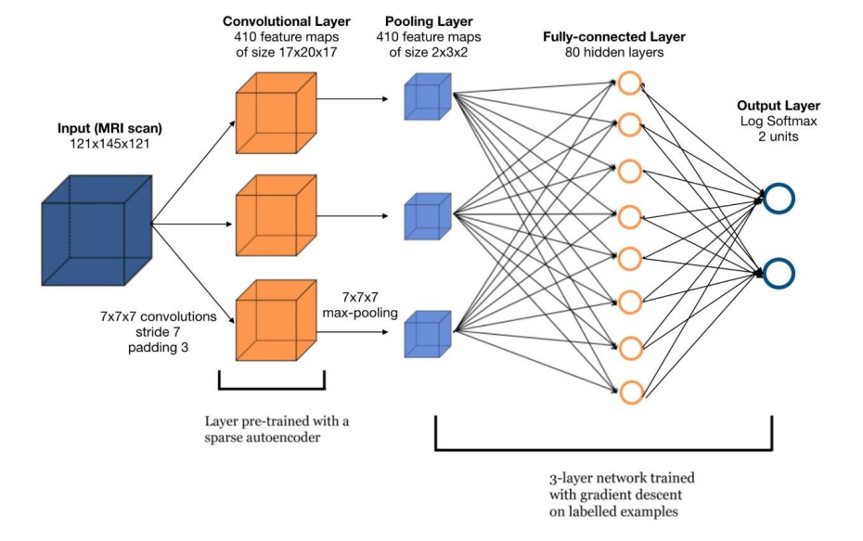
Architecture Diagram

Slide 18
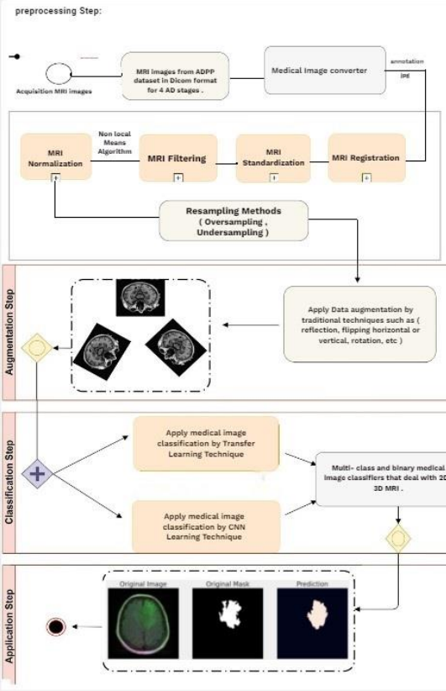
—SOMEONE FAMOUS

Slide 19
Tech Stack:
MRI Images
Masking
We have taken sample test cases of inputs in datasets through kaggle
used in image processing and computer vision to selectively highlight or suppress certain features or areas of an image
CNN
Transfer-Learning
used in our model for their ability to extract features from medical images and classify them accurately.
utilizing pre-trained models on large datasets to improve the accuracy and efficiency of training a new model on a smaller dataset.

Slide 20
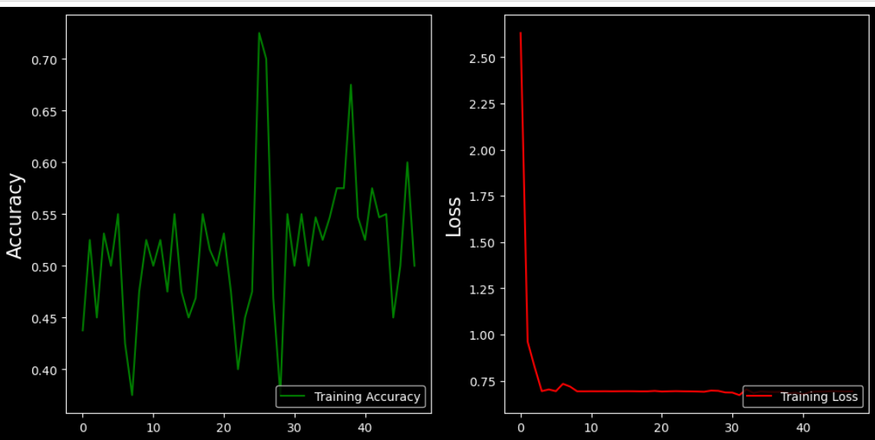
Precision of our model

Slide 21
FUTURE PLANS:
We will integrate this model for the further development of our model to detect the origin of Blood Clot
Integrating other non-imaging data such as electronic health records, cognitive assessments, and genomics data to improve the accuracy of diagnosis
Creating user-friendly interfaces that can be used by healthcare professionals to facilitate diagnosis and treatment.
Integrating different imaging modalities such as PET, CT scans, and other neuroimaging techniques to improve the accuracy of diagnosis.
Developing more accurate and efficient CNN models that can identify the diseases with high accuracy.

Slide 22
References:
https://www.oasis-brains.org/#data
https://archive.ics.uci.edu/ml/datasets/parkinsons

Slide 23
OUR TEAM
Omisha Singal
Kilaru Sai Hemanth
Santhana Lakshmi
RA2011027010103
os4624@srmist.edu.in
RA2011003010654
kh8351@srmist.edu.in
RA2011027010129
sl6253@srmist.edu.in

